Slide 1

Advanced Project in Robotics
Concept Plan for An Automated Crane–Conveyor–Vehicle System (ACCVS).
Group Members: Henrietta Okafor, Dimple Dimple, Nguyen An Ninh, Mounaim Errahmouni.
06.02.2026

Slide 2
Project Overview
The project aims to design an automated system where a crane picks objects from the ground, places them on a conveyor belt, and transfers them to a vehicle, which then returns to repeat the cycle.

Slide 3
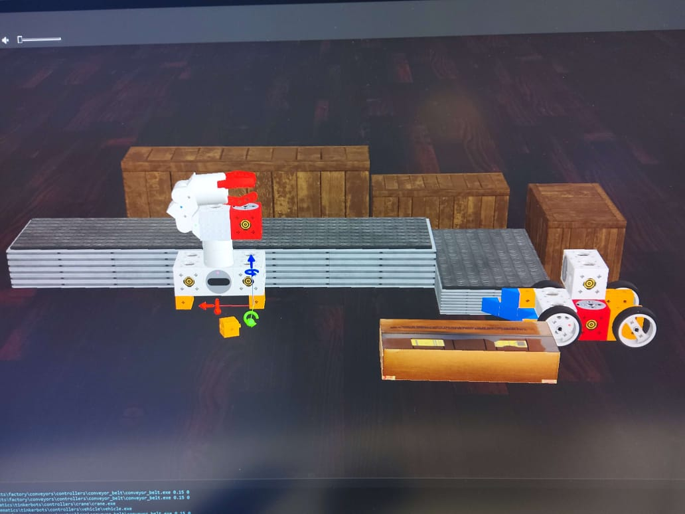

Slide 4
2. Objectives
Automate the loading and transportation process.
Reduce manual labor and human error.
Improve efficiency and consistency in material handling.

Slide 5
3. System Components
Crane:
Grabs and lifts objects from the ground using a robotic manipulator equipped with joint position sensors for motion control, a touch sensor in the gripper to confirm successful grasping, and a distance sensor or camera to detect the object’s position.
Conveyor Belt:
Transports objects from the crane to the vehicle using motorized rollers controlled by motor encoders for speed regulation and a distance or light sensor at the end of the belt to detect object arrival.

Slide 6
Vehicle:
Receives the object and pushes it back toward the crane using proximity or distance sensors to detect the object, wheel encoders for movement control, and an optional touch sensor to confirm contact during pushing.
Control System:
Coordinates the movements and timing of all components using a sensor-based control logic, such as a finite-state machine (FSM), to enable synchronized and repetitive operation.

Slide 7
4. Working Principle
The crane detects and picks up an object using its sensors and places it onto the conveyor belt. The conveyor belt transports the object to the vehicle, where sensors detect its arrival. The vehicle then pushes the object back to the crane’s starting position, after which the process repeats automatically in a closed-loop cycle.

Slide 8
5. Expected Outcome
A functional simulated prototype demonstrating an efficient, repeatable, and automated material transfer process, highlighting coordinated multi-robot operation suitable for industrial and logistics applications.

Slide 9
Thank you.

